Slide 1
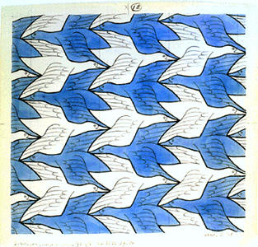
Page 64-A
Tessellation
“Regular Tiling”
Plane-Filling Pattern
One shape interlocks with its own replicas to cover a surface with no gaps or overlaps.
Michael S. Schneider
www.constructingtheuniverse.com

Slide 2
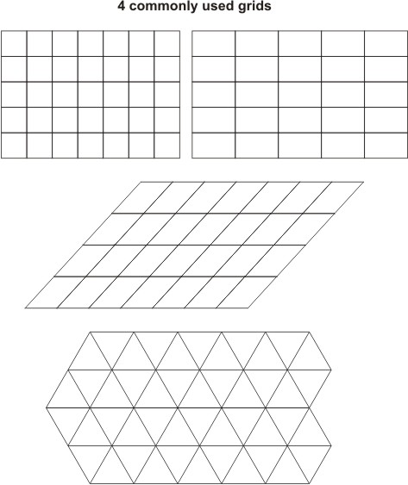
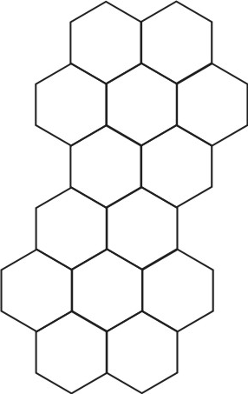
Page 64-A
Begin with a space-filling grid (a regular divisions of the plane):
Squares
Rectangles
Parallelagrams
Triangles
Hexagons
...others
3, 4, 6 – Numbers of Structure

Slide 3
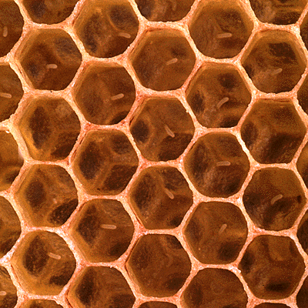
Beehive
Hexagons

Slide 4
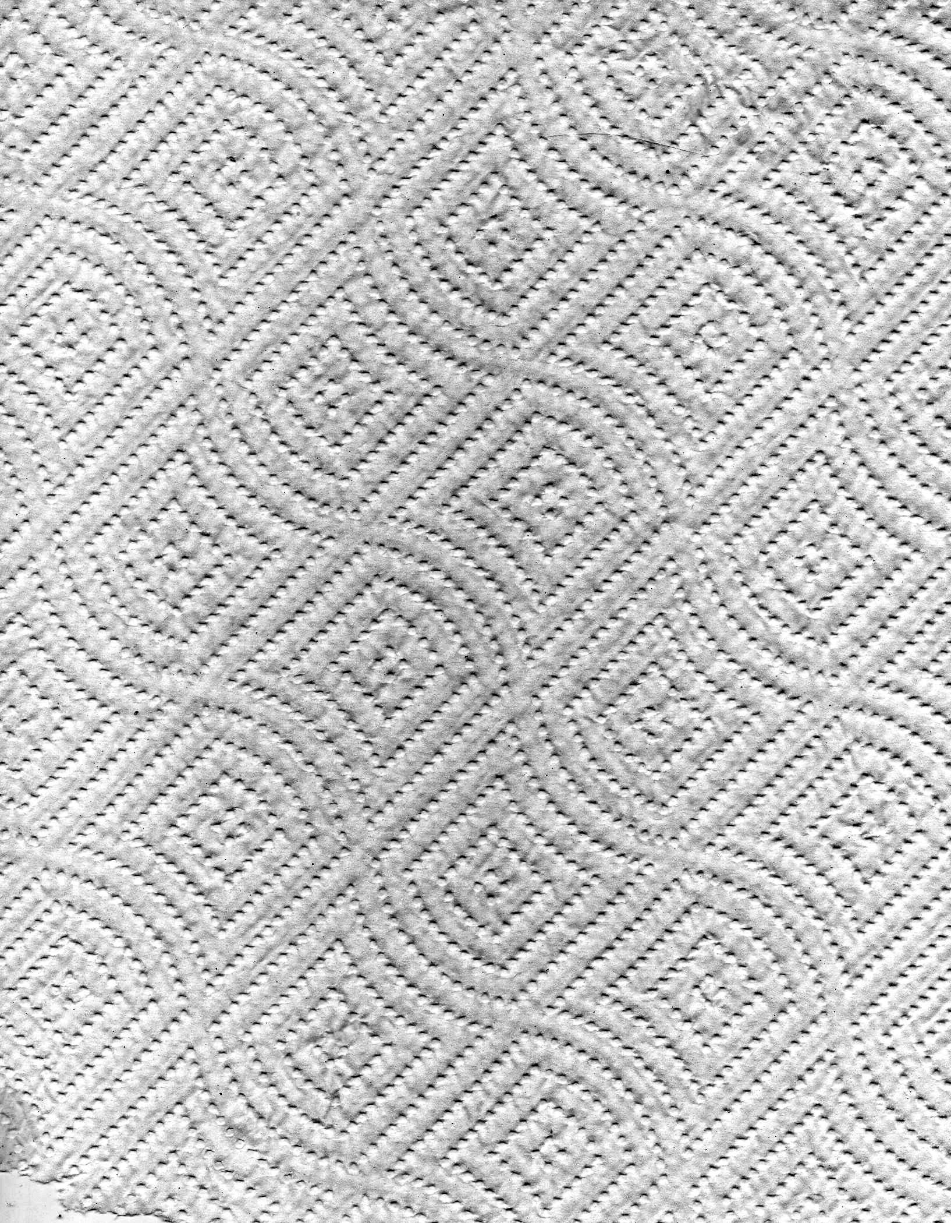

Slide 5
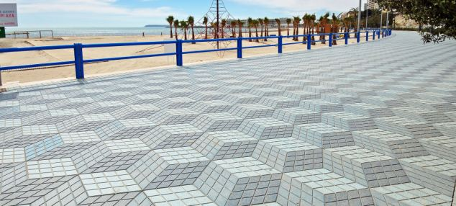
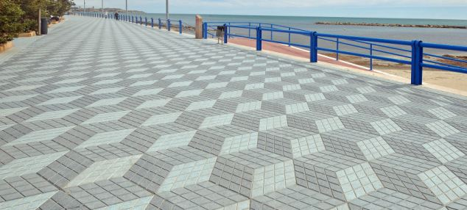

Slide 6
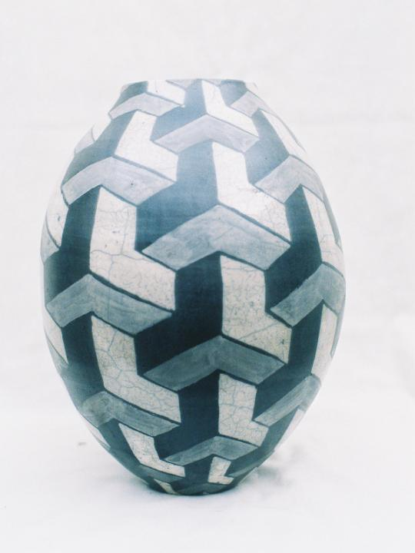

Slide 7


Slide 8
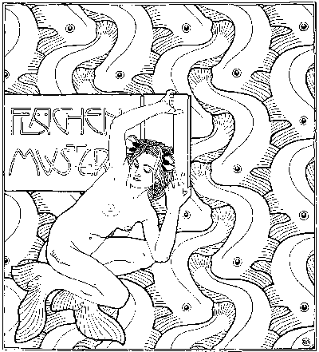
Vienna 1899
Earliest known tessellation depicting recognizable objects, not only geometry

Slide 9
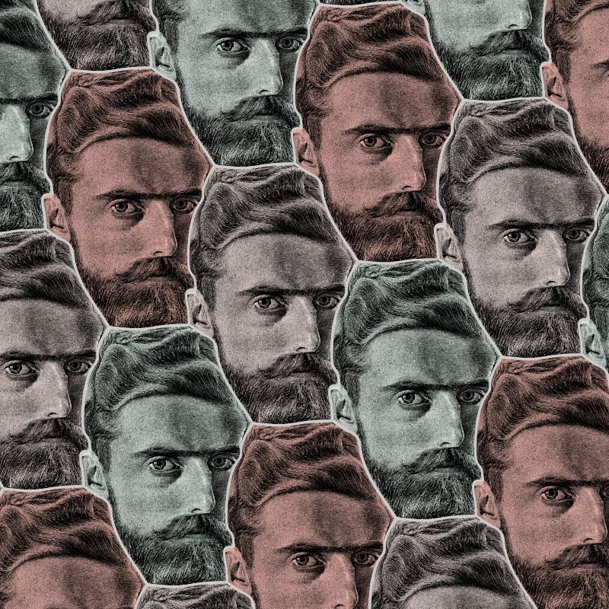
M. C. Escher
1898-1972
Developed the idea of creating
tessellations depicting recognizable objects.
See mcescher.com

Slide 10
Three main types of tessellation:
Glide
Glide-Reflection
Rotation

Slide 11
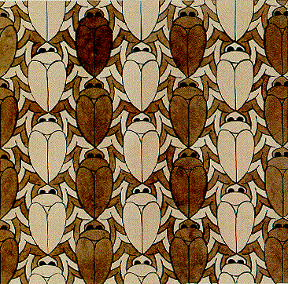
1 - Glide
One form repeats and
moves in the same direction

Slide 12
2 - Glide-Reflection
The same shape moves in alternating directions

Slide 13
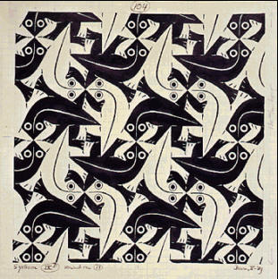
3 - Rotation
The same shape rotates around a point.
Where are the points of rotation?

Slide 14
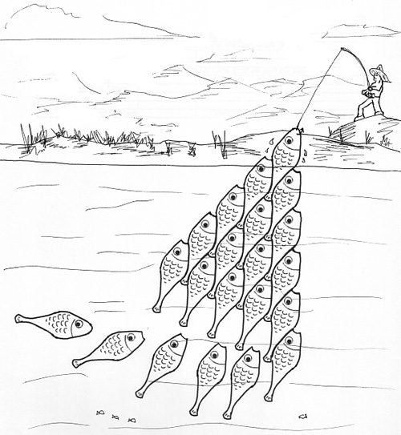
Which type of tessellation is this?

Slide 15
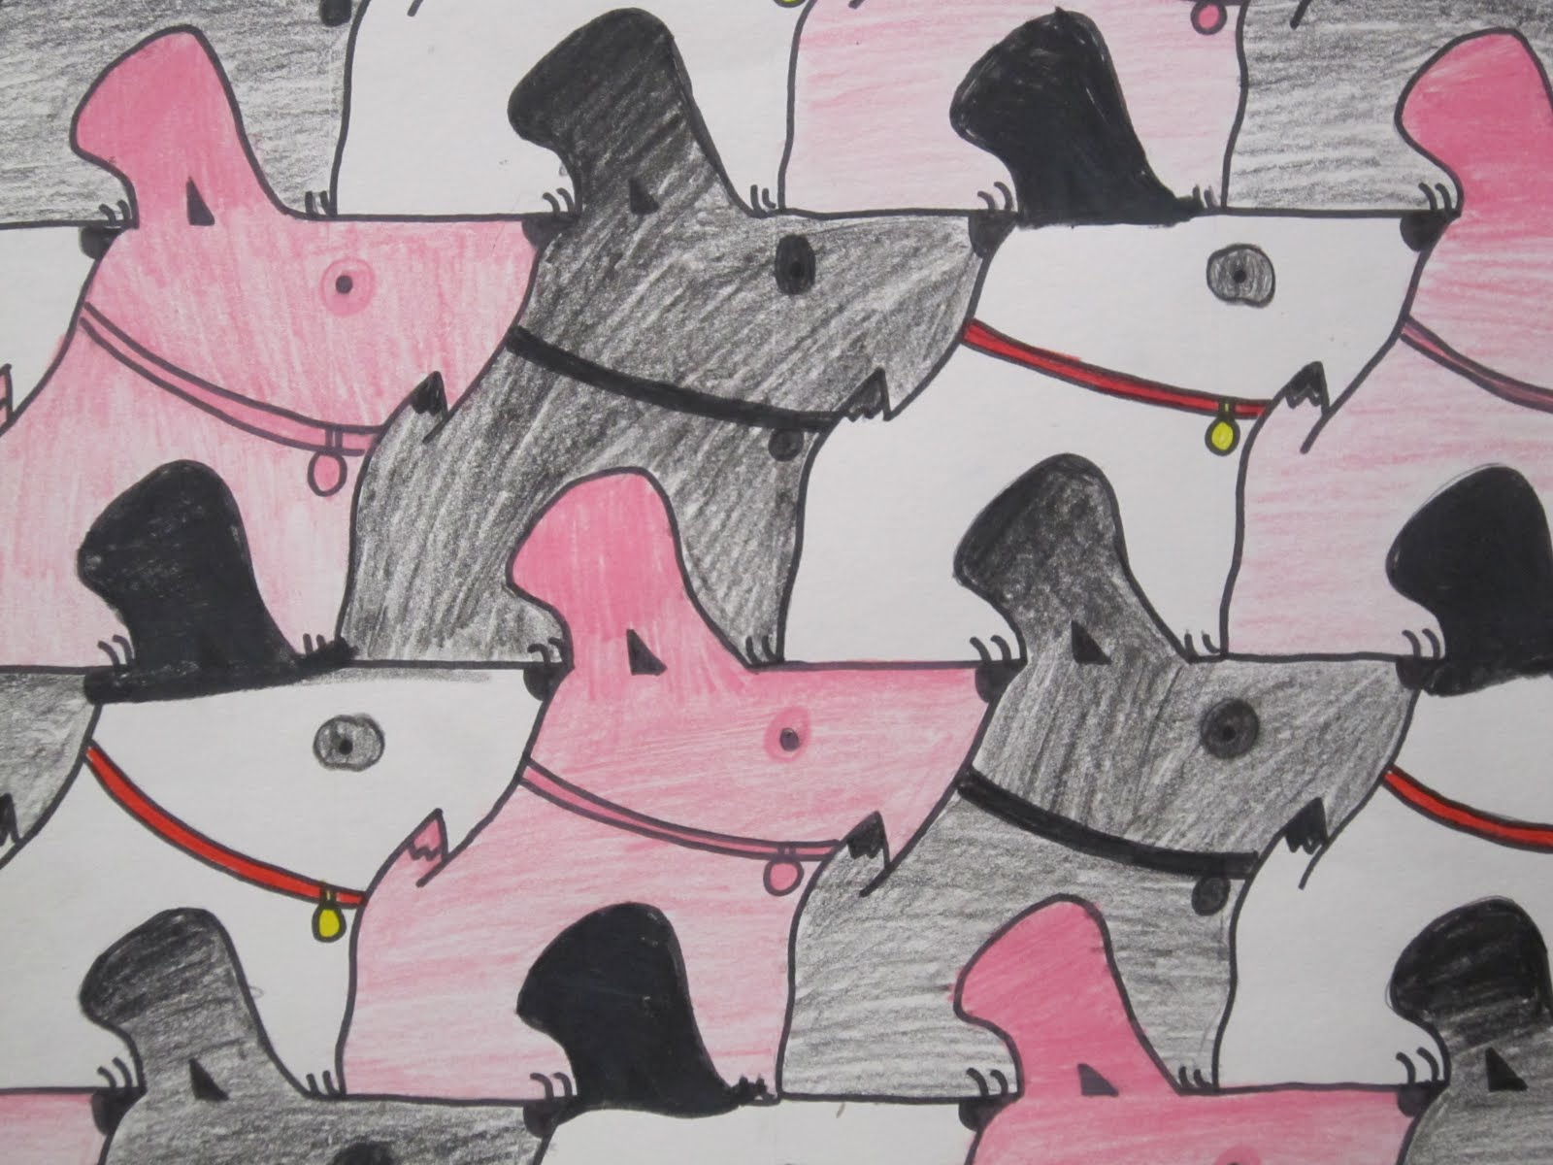
1 - Glide

Slide 16
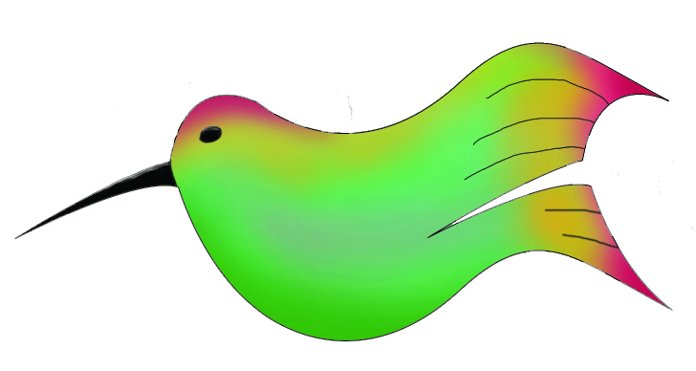

Slide 17
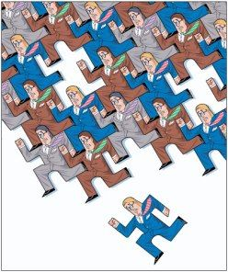

Slide 18
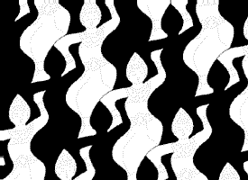
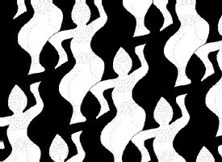

Slide 19
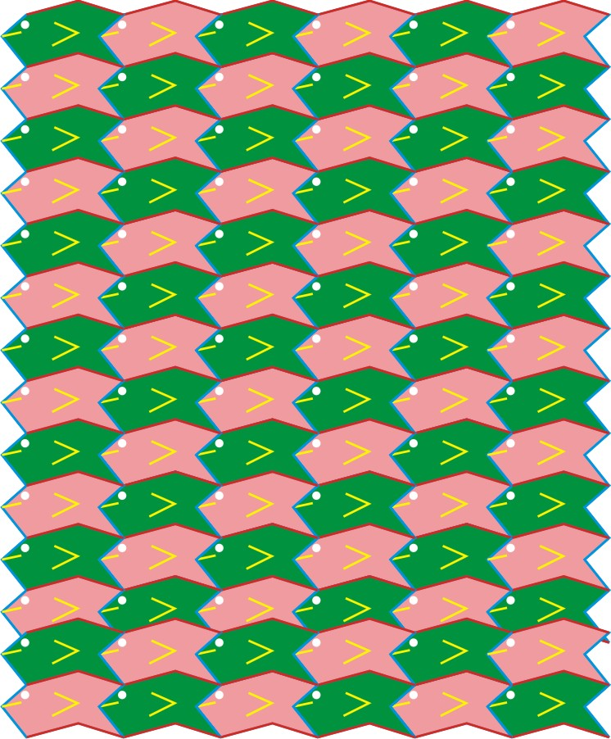
A school of fish
(University of Wales?)
Page 64-B

Slide 20
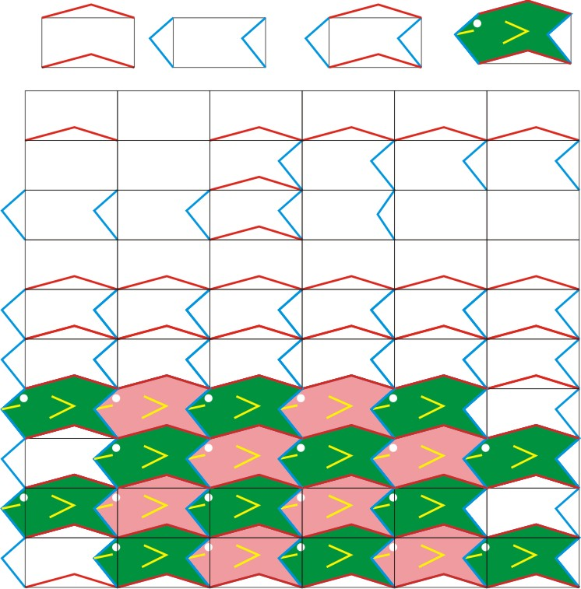
Repeat on horizontal lines
Page 64-B
Repeat on vertical lines
Fill in the details
Combined

Slide 21
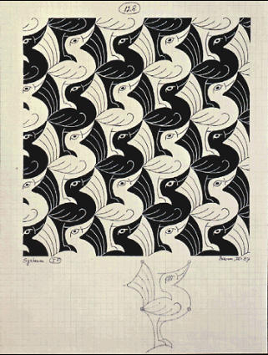
Page 64-C
Which grid?
Which 2 lines repeat to make all this?

Slide 22
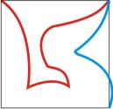
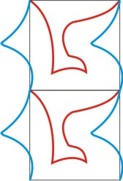
Page 64-C
Just repeat these 2 lines

Slide 23
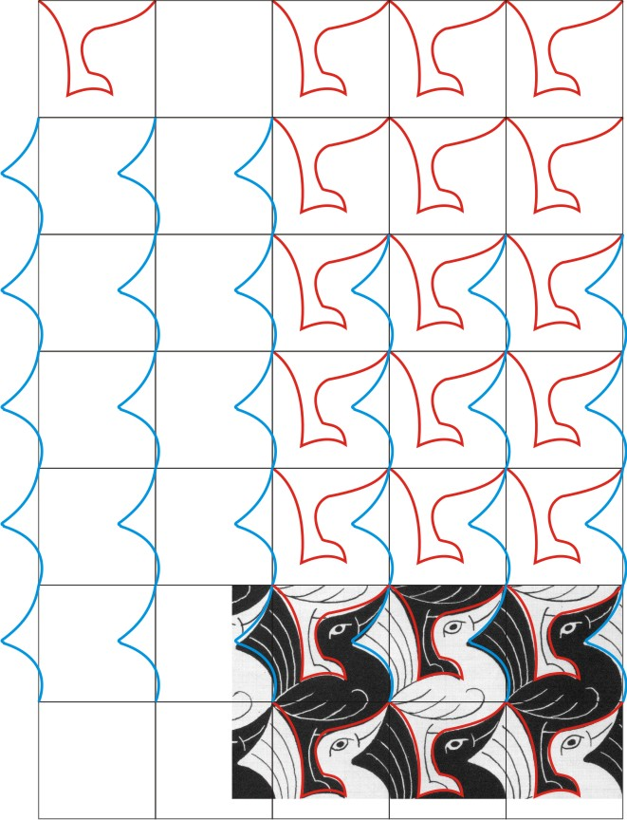
Page 64-C

Slide 24
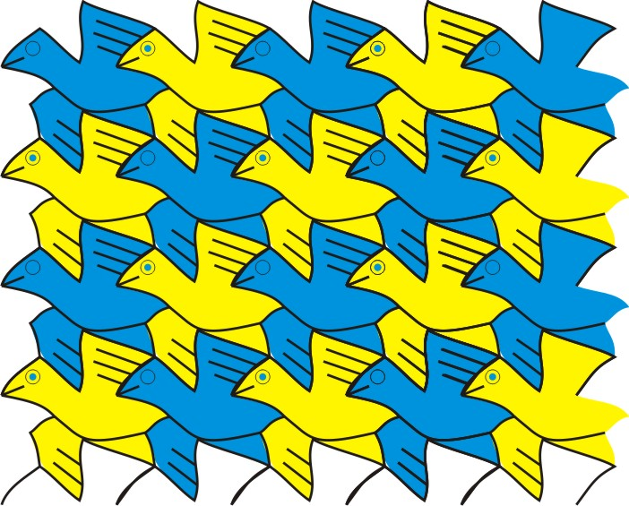
Page 64-D

Slide 25
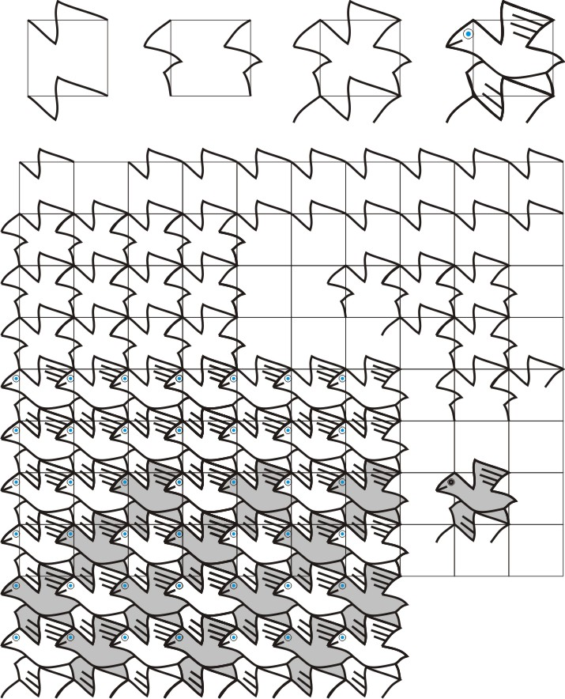
Repeat on horizontal lines
Page 64-D
Repeat on vertical lines
Fill in the details
Combined

Slide 26
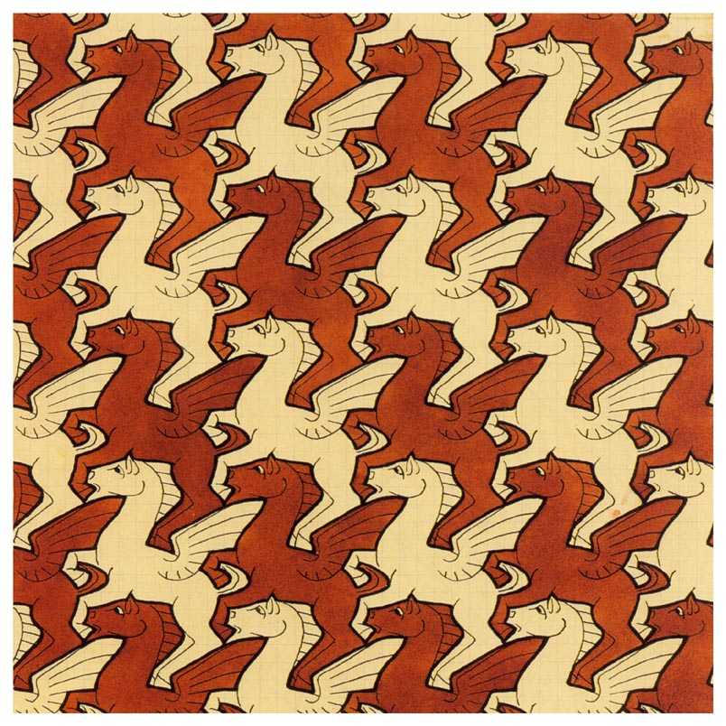
Page 64-E

Slide 27
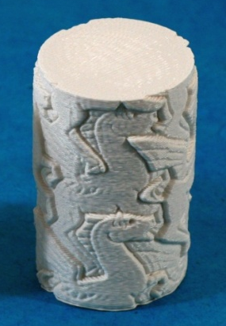
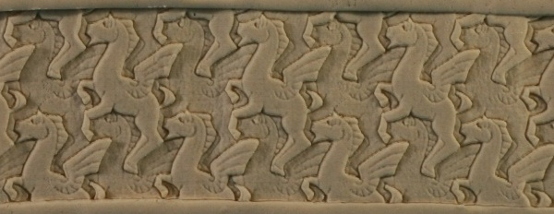
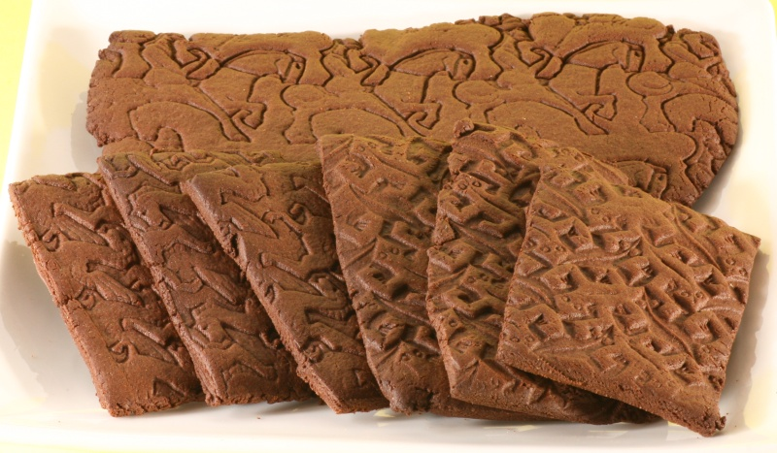

Slide 28
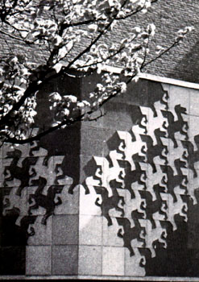

Slide 29
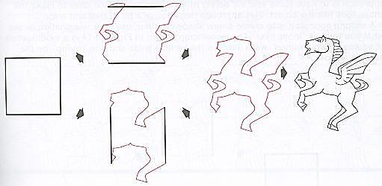
Page 64-E
Just repeat these 2 lines

Slide 30
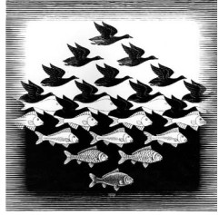

Slide 31


Slide 32
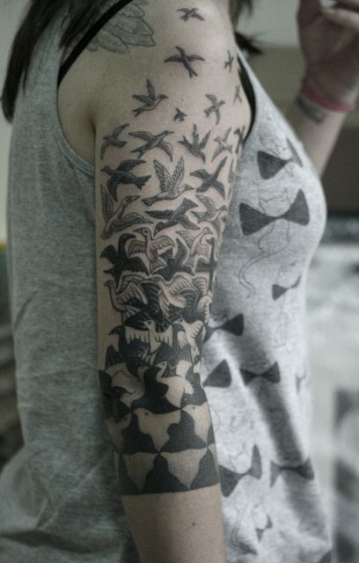

Slide 33

Alexander McQueen “Magpie” dress

Slide 34
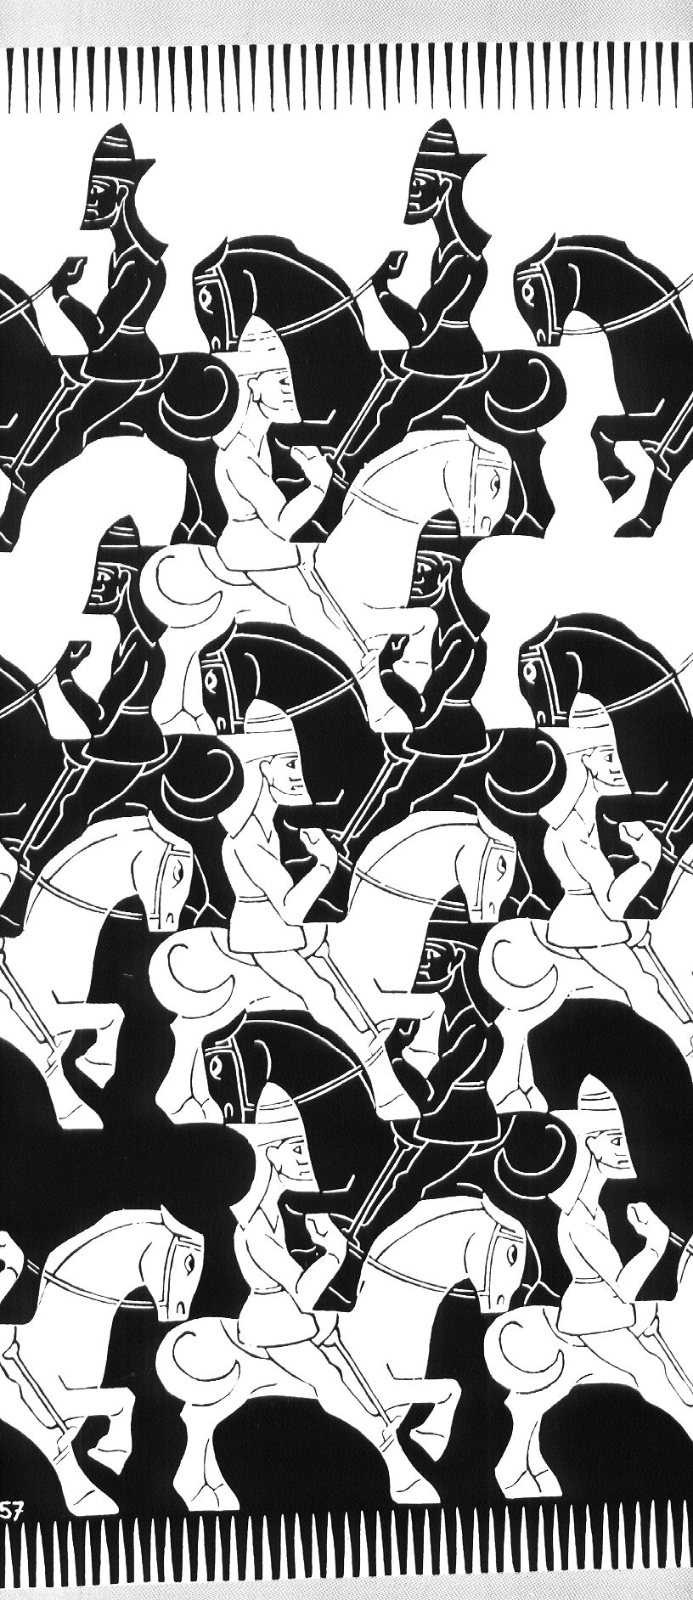
2 - Glide-Reflection

Slide 35
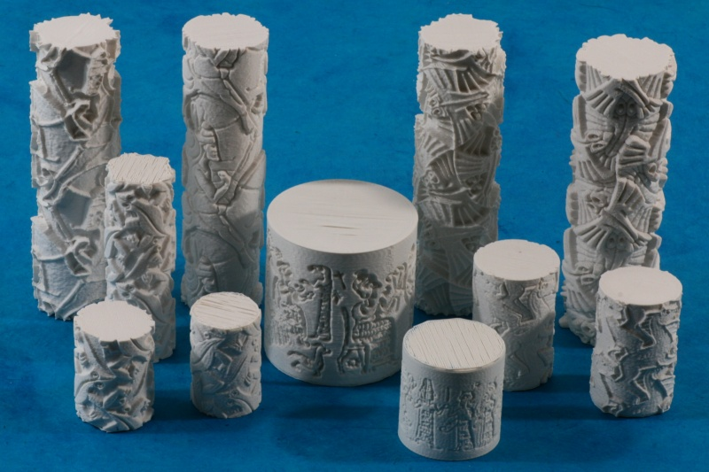
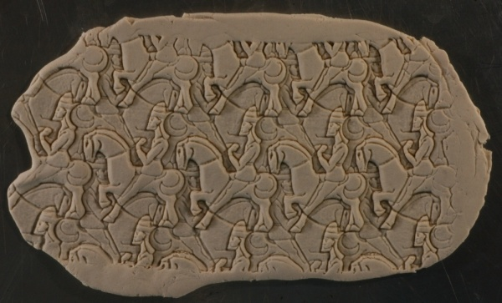

Slide 36
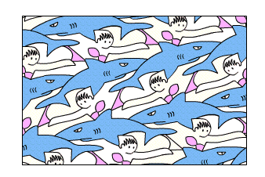

Slide 37
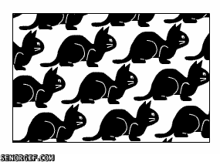

Slide 38
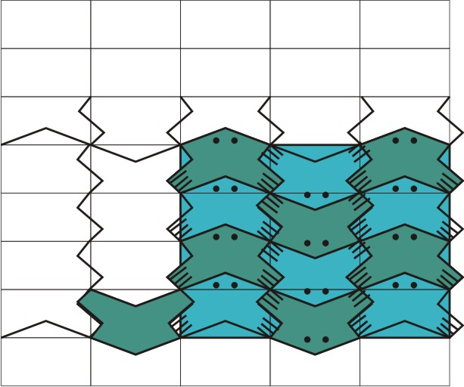
Page 64-F
2 - Glide-Reflection

Slide 39
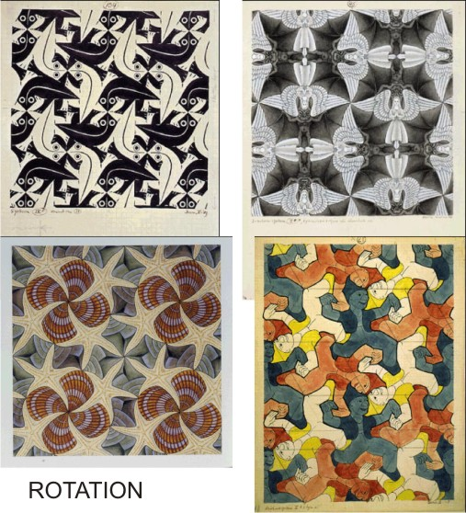

Slide 40
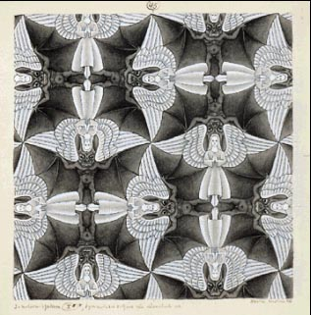
Rotation
Where are the points of rotation?
Which kind of grid underlies this?

Slide 41
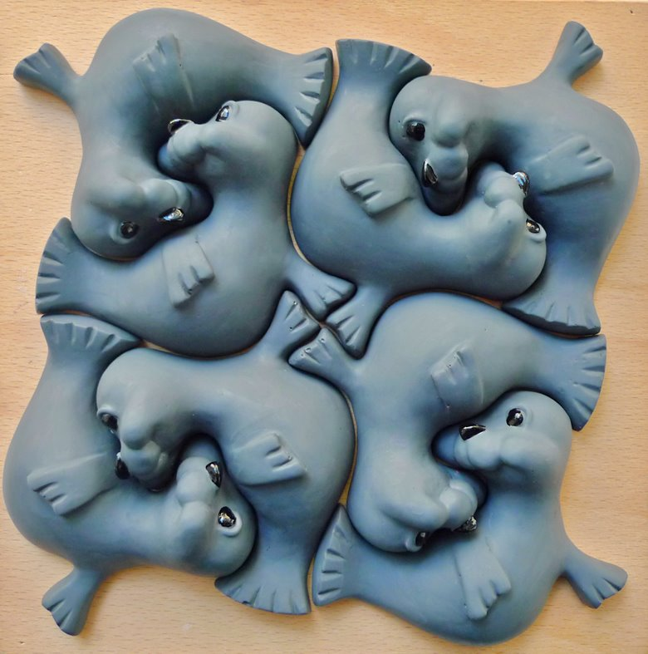

Slide 42
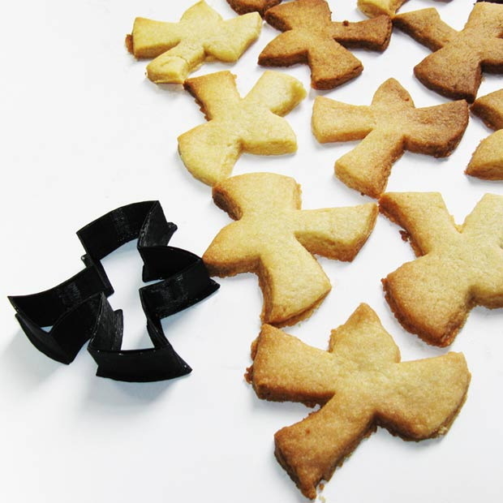
Page 64-G
How to make a Rotation Tessellation
on a triangular grid.

Slide 43
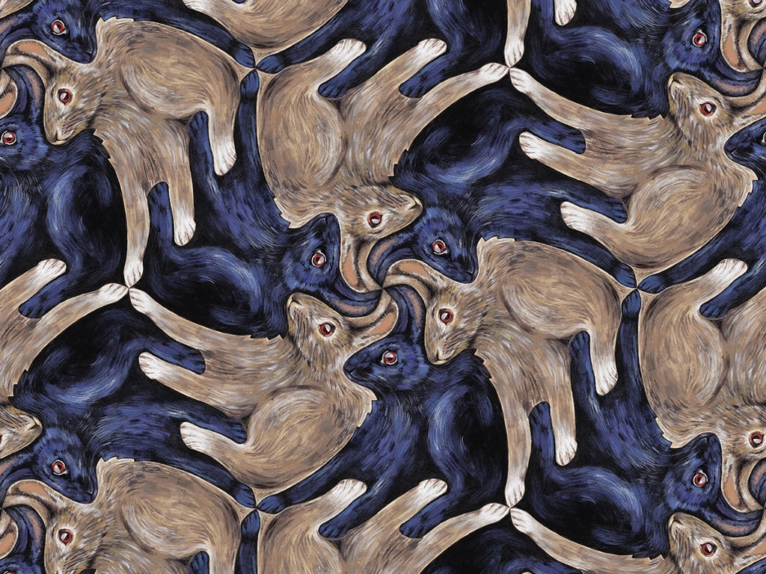

Slide 44
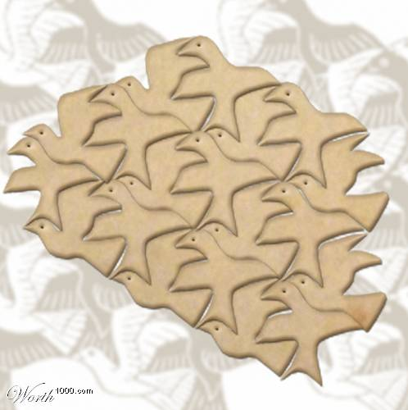
Homework?

Slide 46
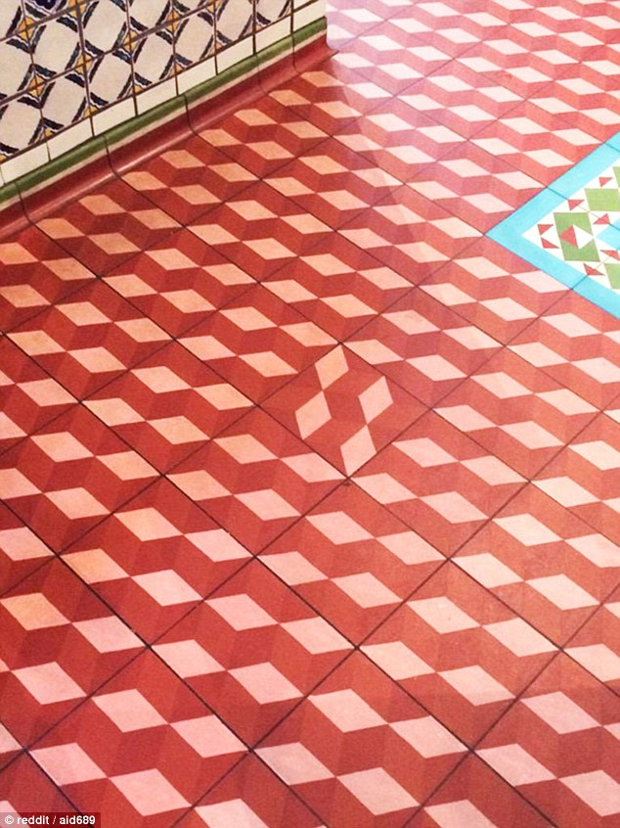

Slide 47
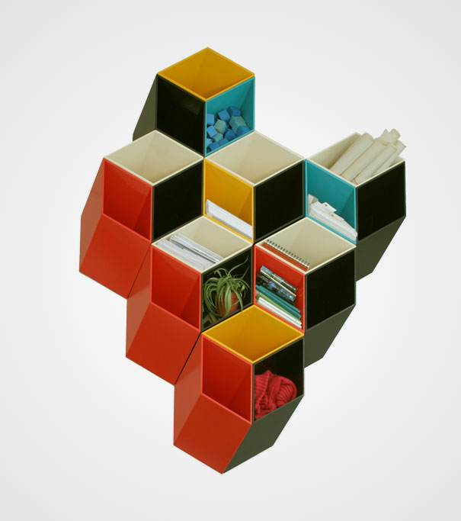
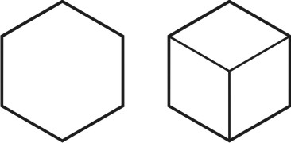
Bookshelf

Slide 48
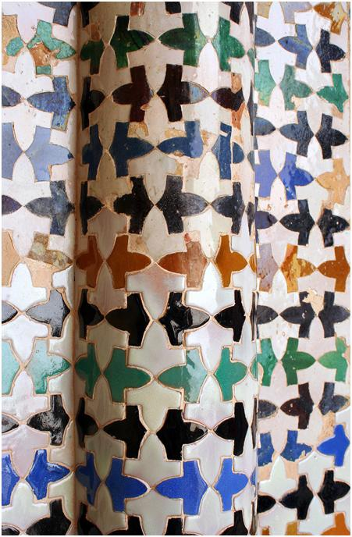
1 shape

Slide 49
1 - Glide
Two birds repeat together as one unit

Slide 50


Slide 51

Anti-vibration design

Slide 52


Slide 53


Slide 54

Where are the points of rotation?

Slide 55



Slide 56


Slide 57

Where are the points of rotation?

Slide 58


Slide 59


Slide 60



Slide 61


Coliseum in the
Netherlands

Slide 62

Look to crystal molecule structures for regular patterns
A Superconductor
Ytterbium
(70)

